Slide 1
Cube Slam
2022.08.23
김정윤

Slide 2
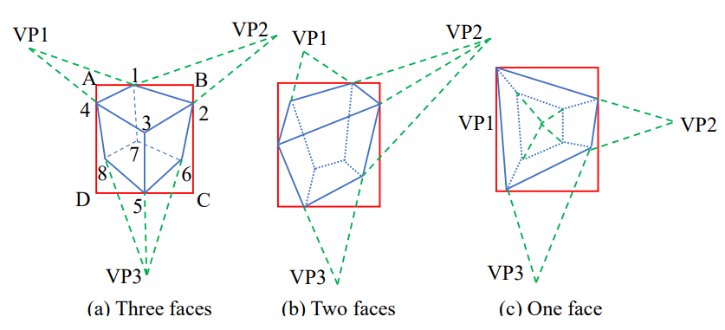
3D Box Generation
Notes:
P2 p4 p3 p5 다른코너들도

Slide 3
3D Box Generation
Arbitrary pose objects
Use PnP solver to solve the general cuboid’s 3D position and dimensions up to a scale factor due to the monocular scale ambiguity.
Ground objects
We can directly back-project ground corner pixels to the 3D ground plane and subsequently compute other vertical corners to form a 3D cuboids.
Notes:
임의 pose object는 pnp solver를 사용하여 직육면체의 3d position과 dimension를 monocular scale ambiguity로 인해 scale factor까지 해결합니다.
Ground object는 복잡한 pnp solver 대신 3D ground plane에 직접 back –project한 다음 다른 vertical corners를 계산하여 3D cuboid를 형성합니다.

Slide 4

Proposal Scoring
Angle alignment error
Shape error
Distance error

Slide 5


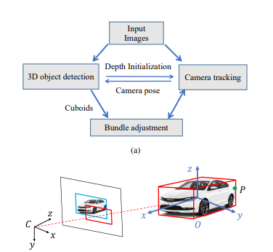
Object SLAM
The system is built on feature point-based ORB SLAM2
Our main change is the modified BA to include objects, points and camera poses together
Notes:
C 카메라 pose
O 3d cuboids
P points
Nonlinear least squares optimization problem

Slide 6
Measurement Error
3D camera-object error
The tracked landmark object has 6DoF pose + 3DoF cuboid dimension, this can be compared with the 9DoF 3D measurement and form the first error terms
2D camera-object error
From the 3d measurement we can project 8corners into the camera image. The minimum bbox of the 8points should be consistent with the 2d detection bbox per frame.
Object-point error
For points associated with bbox, it should lie within the cuboid based on the center and size of the cuboid.

Slide 7
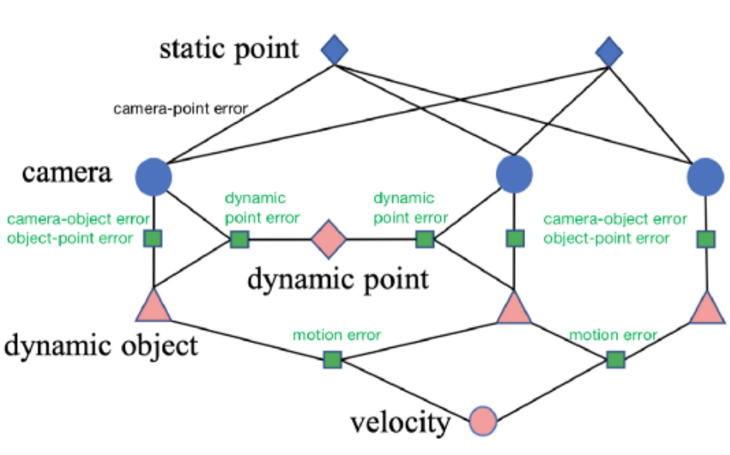
Dynamic SLAM
We propose an approach to jointly estimate the camera pose and dynamic object trajectories
The two commonly used assumptions are that the object is rigid and follows some physically feasible motion model
Notes:
카메라 pose 와 dynamic object trajectories를 공동으로 estimate하는 방식을 제안
두가지 가정
-object는 rigid하고 physically 실현 가능한 motion model을 따른다는 것
Rigid가정은 점의 위치가 시간이 지남에 따라 변경 되지 않는다는 것이고 motion model의 경우 균일한 속도로 일정한 모션 모델입니다.

Slide 8
Data Association
Point-point matching
First, perform keypoints matching based on orb features in the same way as standard ORB-SLAM. For matched keypoints that do not fulfill epipolar constraints, they belong to dynamic objects. For dynamic keypoints, matching by features may fail, and they are directly tracked by sparse optical flow (KLT optical flow). After tracking, the 3D location of the dynamic keypoints will be triangulated.
Point-object matching
For static keypoints, if they belong to the same bounding box, then it is associated with that object. Many heuristics are used here to ensure robust performance. For example, points must be within the same bbox for 2 frames and are less than 1 meter from the cuboid center. Feature points in overlapping areas between boxes are ignored.
Object-object matching
Object matching is done indirectly via matched keypoints. If two objects in consecutive frames share the most feature points (and more than 10), then they are tracked as the same object. In case feature-based matching or KLT tracking fails, dynamic object tracking is done with visual object tracking methods on the bounding box level.

Slide 9
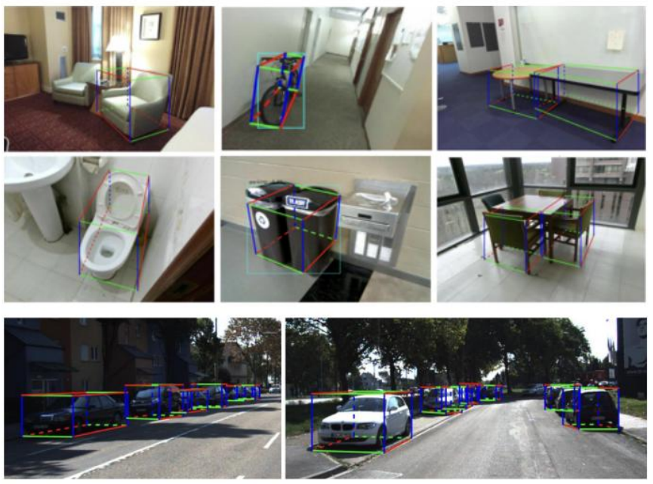
Experiments

